Slide 1
Top Industry News
2025-12-11 to 2025-12-18

Slide 2

PLDT
PLDT Unveils 12th Data Center, First AI-Ready Hyperscale Facility
PLDT Group confirms plans for its 12th data center in Cavite, a US$1 billion investment with 100MW IT load capacity, making it the largest Vitro facility. This coincides with the launch of its first AI-ready hyperscale facility in Sta. Rosa, Laguna, significantly boosting data center capacity for growing digital demands and positioning PLDT to attract international cloud providers.
Source: Light Reading (search for article)

Slide 3

PLDT
PLDT Positions AI as Key Driver for Philippine Economic Growth
A PLDT executive emphasizes Artificial Intelligence (AI) as a critical driver for the Philippines' economic growth, potentially contributing 8% to 12% to the GDP by 2030. PLDT highlights three pillars for AI's potential: robust infrastructure (including 5G Standalone and distributed edge), world-class talent development, and trustworthy governance, aiming for the Philippines to become an 'archipelago intelligence' leader.
Source: Manila Standard (search for article)

Slide 4

Philippines Market
Philippine Telco Sector Exceeds Global Economic Contribution Benchmark
A GSMA report reveals the Philippine mobile industry contributes 8.4% to 8.6% of the country's GDP, surpassing the global average of 7.7%. This underscores the sector's significant economic impact. The report also notes high internet consumption and increasing AI platform adoption among Filipinos, signaling further digital transformation opportunities.
Source: Philstar.com

Slide 5

Philippines Market
New 'Konektadong Pinoy Act' Mandates Strict Cybersecurity for DTIPs
The Konektadong Pinoy Act introduces mandatory cybersecurity certification and audit duties for Data Transmission Internet Providers (DTIPs) in the Philippines. This regulatory shift aims to protect personal data and confidential business information, making cybersecurity compliance a condition for operation. The DICT and NTC will provide guidance and maintain a public registry of DTIPs' cybersecurity status.
Source: Legal 500

Slide 6

Philippines Market
📈 Trending: Globe Business Engages Partners and Communities with GDay 2025
This trending article highlights Globe Business's GDay 2025 event, focusing on its efforts to connect with partners and communities. The article garnered 365 social shares, indicating high public and business engagement.
Source: bworldonline.com

Slide 7
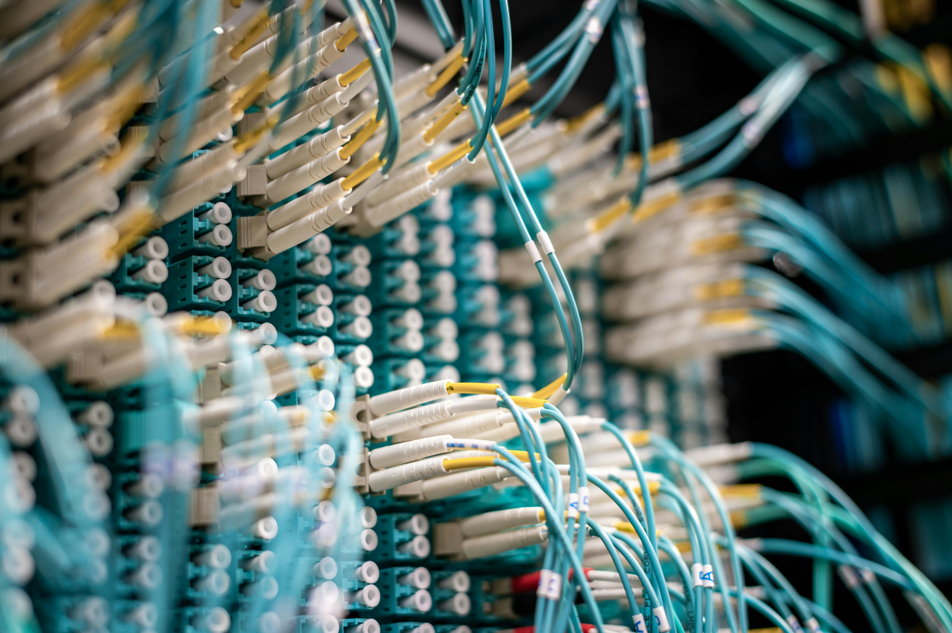
Philippines Market
📈 Trending: Globe Plans Major Submarine Cable Project in Mindanao
This trending article reports on Globe's plans for a new submarine cable project in Mindanao. The news generated 276 social shares, indicating significant interest in infrastructure development in the southern Philippines.
Source: manilatimes.net

Slide 8

Philippines Market
📈 Trending: vivo Y21d Highlighted as a Smart Buy for Consumers
This trending article from Philstar.com discusses the vivo Y21d smartphone, positioning it as a smart purchase for consumers. It received 119 social shares, indicating consumer interest in mobile device recommendations.
Source: philstar.com

Slide 9

Philippines Market
📈 Trending: Luvpark Launches Smart Parking App to Ease Urban Congestion
This trending article from BusinessWorld Online features Luvpark's new smart parking application, aimed at alleviating motorists' struggles. The article garnered 47 social shares, reflecting public interest in smart city solutions.
Source: bworldonline.com

Slide 10
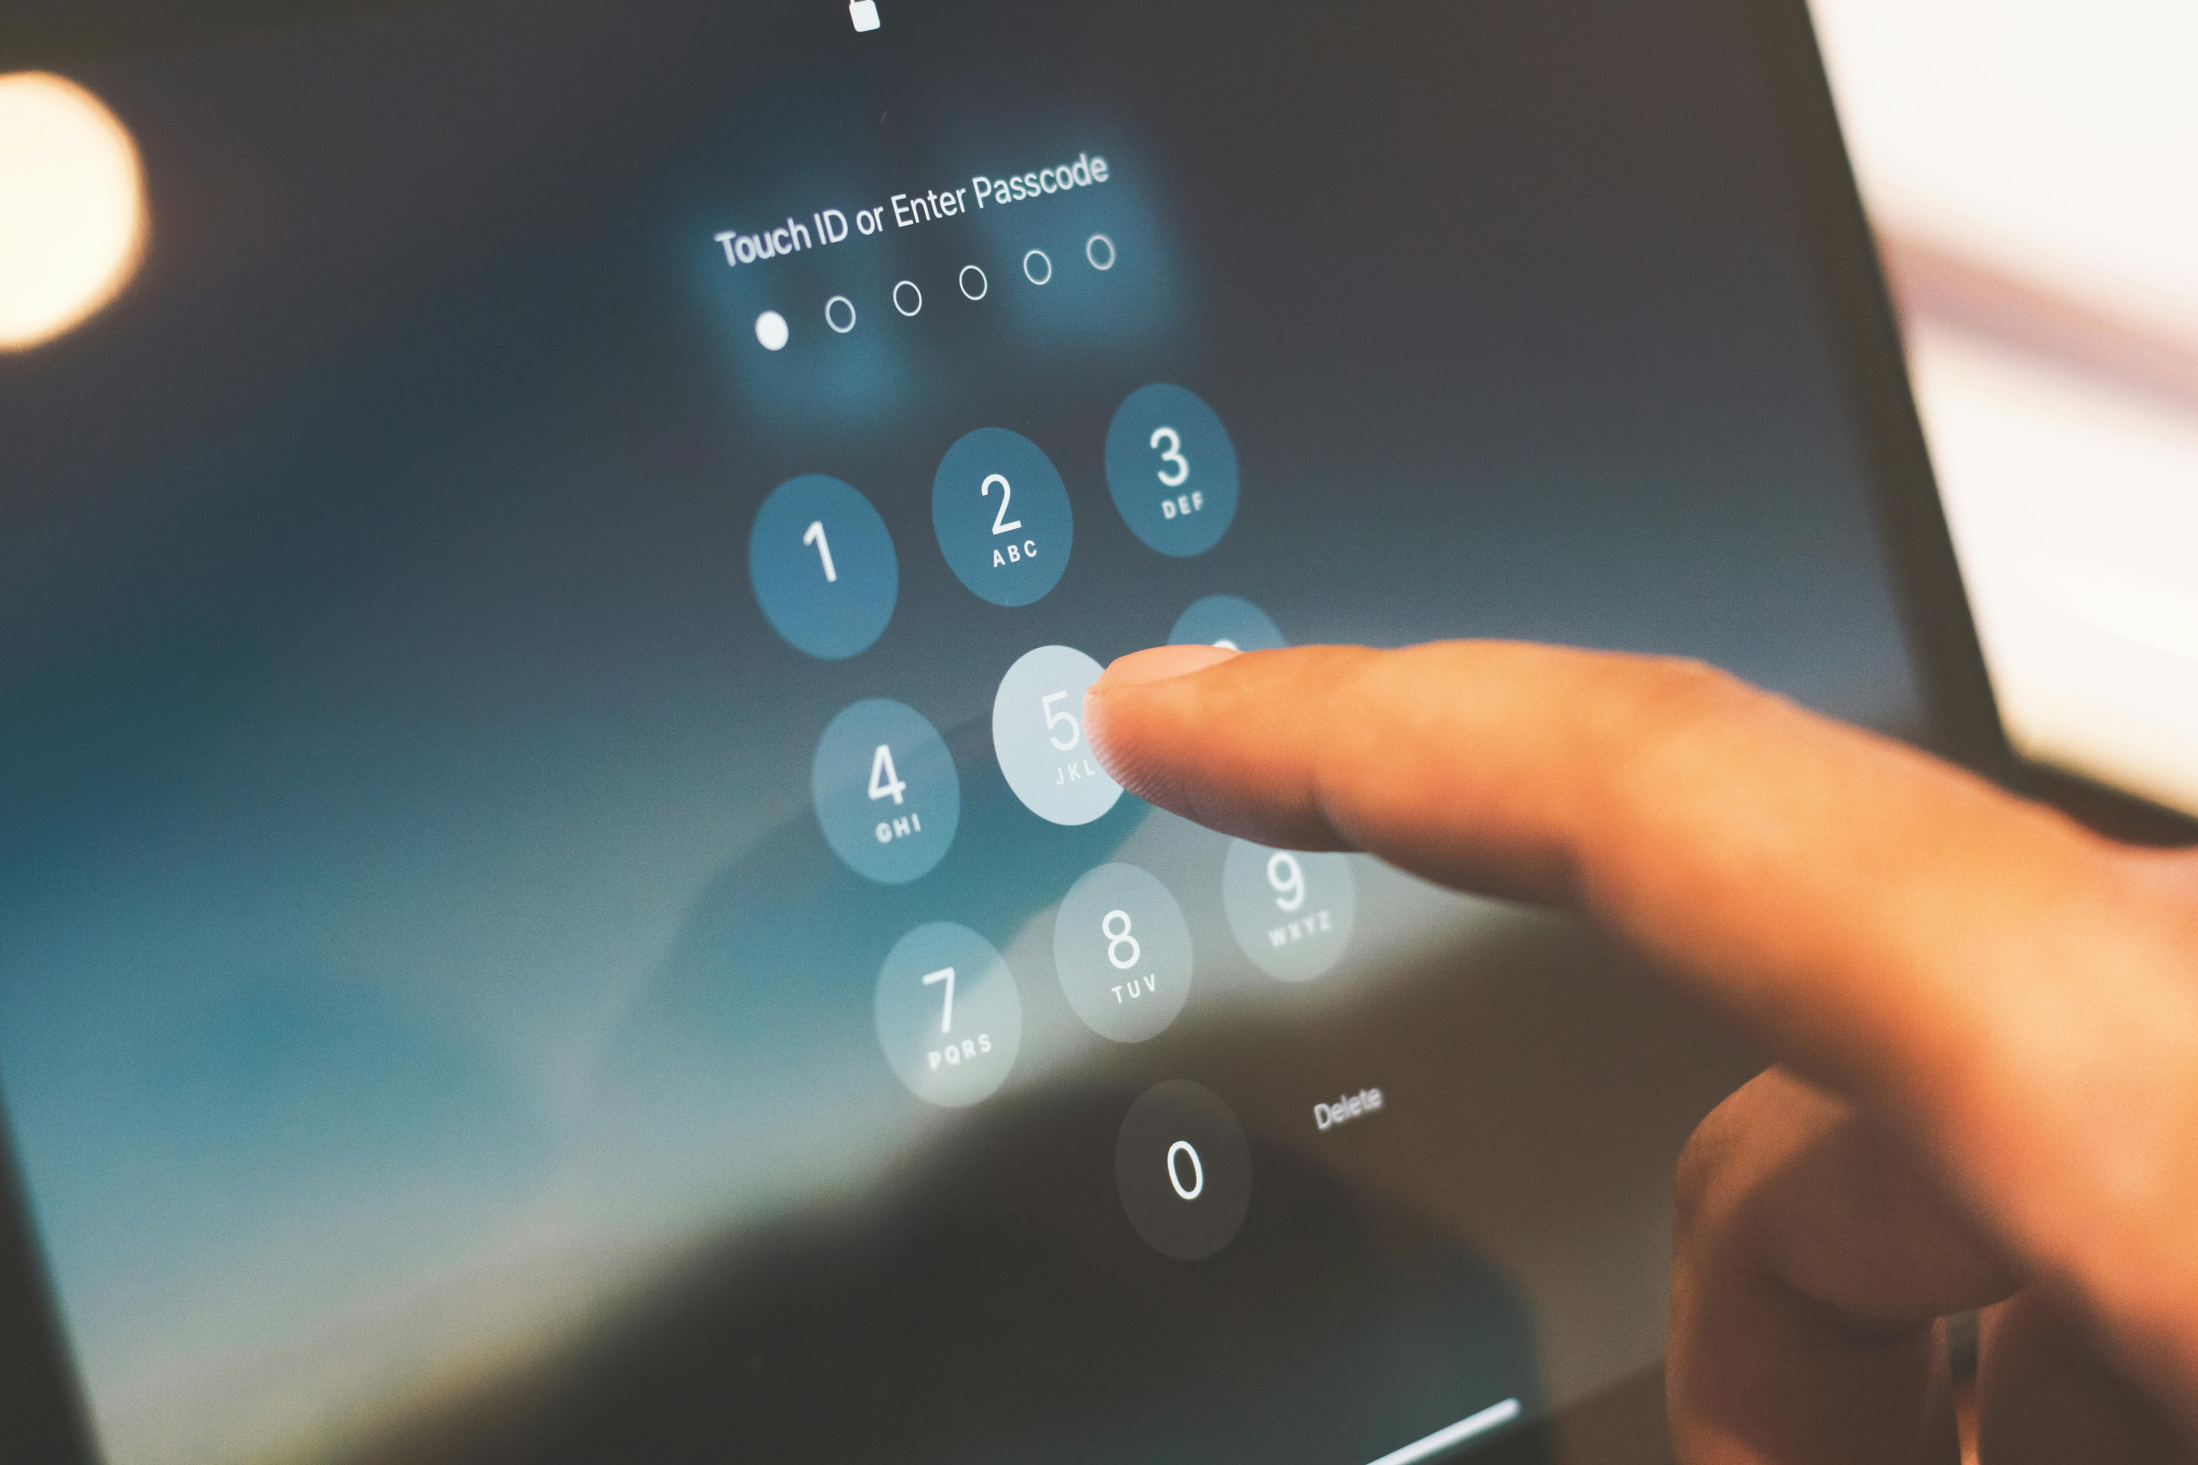
Philippines Market
📈 Trending: Globe & GCash Advance Silent Network Authentication
This trending article reports on Globe and GCash completing initial tests for silent network authentication implementation. With 34 social shares, it highlights progress in secure and seamless digital transactions.
Source: rappler.com

Slide 11
Philippines Market
📈 Trending: Manuel Signs Deal with Converge
This trending article from manilatimes.net reports on Manuel inking a deal with Converge. The news received 20 social shares, indicating interest in partnerships and business developments.
Source: manilatimes.net

Slide 12
Philippines Market
📈 Trending: Converge Competes Against Meralco for Top 4 Spot
This trending article from manilatimes.net covers Converge taking on Meralco in a race for a top 4 position. With 16 social shares, it highlights competitive dynamics in the market.
Source: manilatimes.net

Slide 13
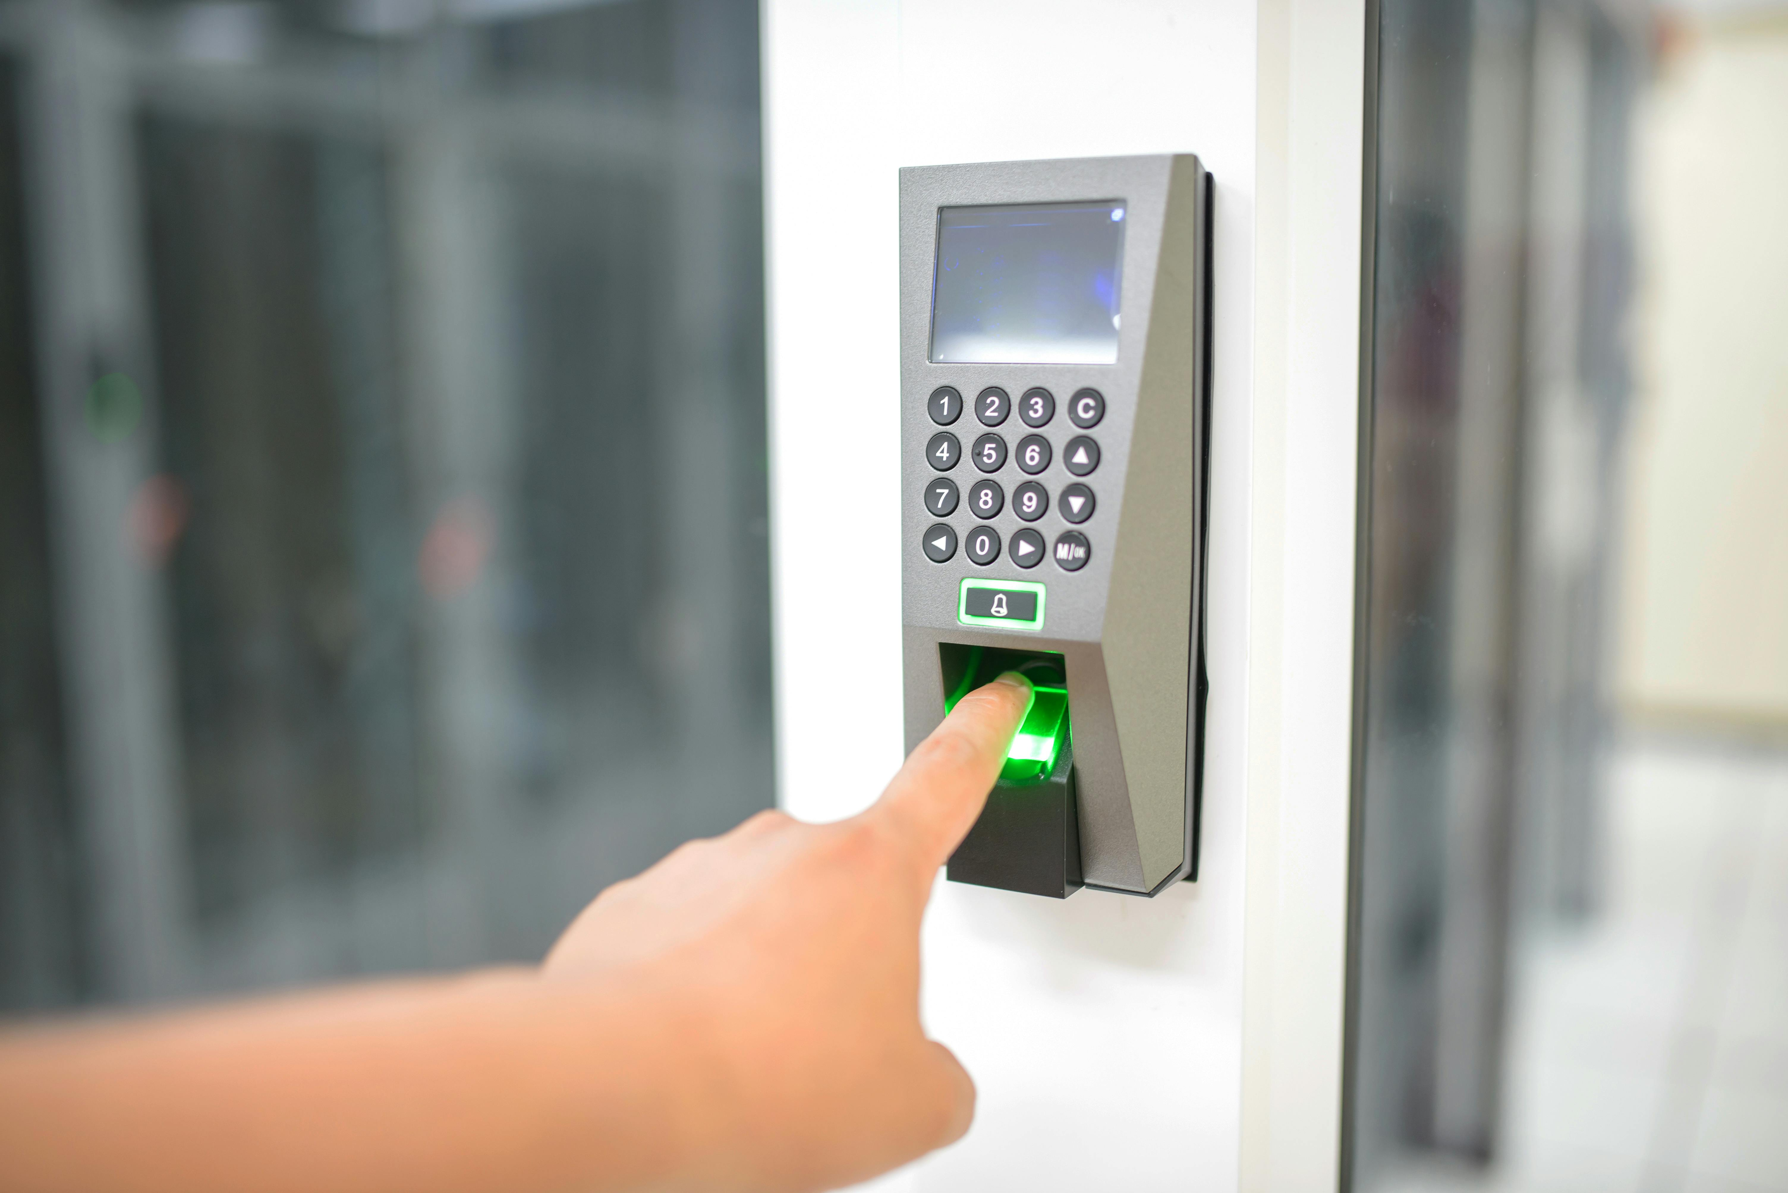
Philippines Market
📈 Trending: Globe & GCash Conclude Initial Silent Authentication Tests
This trending article from BusinessWorld Online reports on Globe and GCash completing initial tests for silent authentication. The news garnered 15 social shares, underscoring interest in enhanced digital security.
Source: bworldonline.com

Slide 14
Philippines Market
📈 Trending: Globe & GCash Successfully Finish Silent Authentication Trials
This trending article from manilatimes.net confirms Globe and GCash have finished initial silent authentication tests. With 12 social shares, it reinforces the positive reception of this security advancement.
Source: manilatimes.net

Slide 15

Philippines Market
📈 Trending: DICT Reports 38% Drop in Cybercrime Cases for 2025
This trending article from newsbytes.ph indicates a 38% fall in cybercrime cases in 2025, with online libel topping the list. The news, with 8 social shares, highlights efforts in digital security and law enforcement.
Source: newsbytes.ph

Slide 16

Philippines Market
📈 Trending: Globe Business Connects with Partners at GDay 2025
This trending article from philstar.com reiterates Globe Business's GDay 2025 event, focusing on its engagement with partners and communities. It received 6 social shares, indicating continued interest in the event.
Source: philstar.com

Slide 17

Philippines Market
📈 Trending: Globe & BPI Launch 'G Verify' Silent Network Authentication
This trending article from rappler.com announces Globe and BPI's introduction of the new G Verify silent network authentication. With 4 social shares, it highlights a new secure verification method.
Source: rappler.com

Slide 18

Philippines Market
📈 Trending: Meralco Defeats Converge, Strengthens Top 4 Position
This trending article from manilatimes.net reports on Meralco's victory over Converge, boosting its bid for a top 4 spot. The news, with 3 social shares, reflects ongoing competitive dynamics.
Source: manilatimes.net

Slide 19
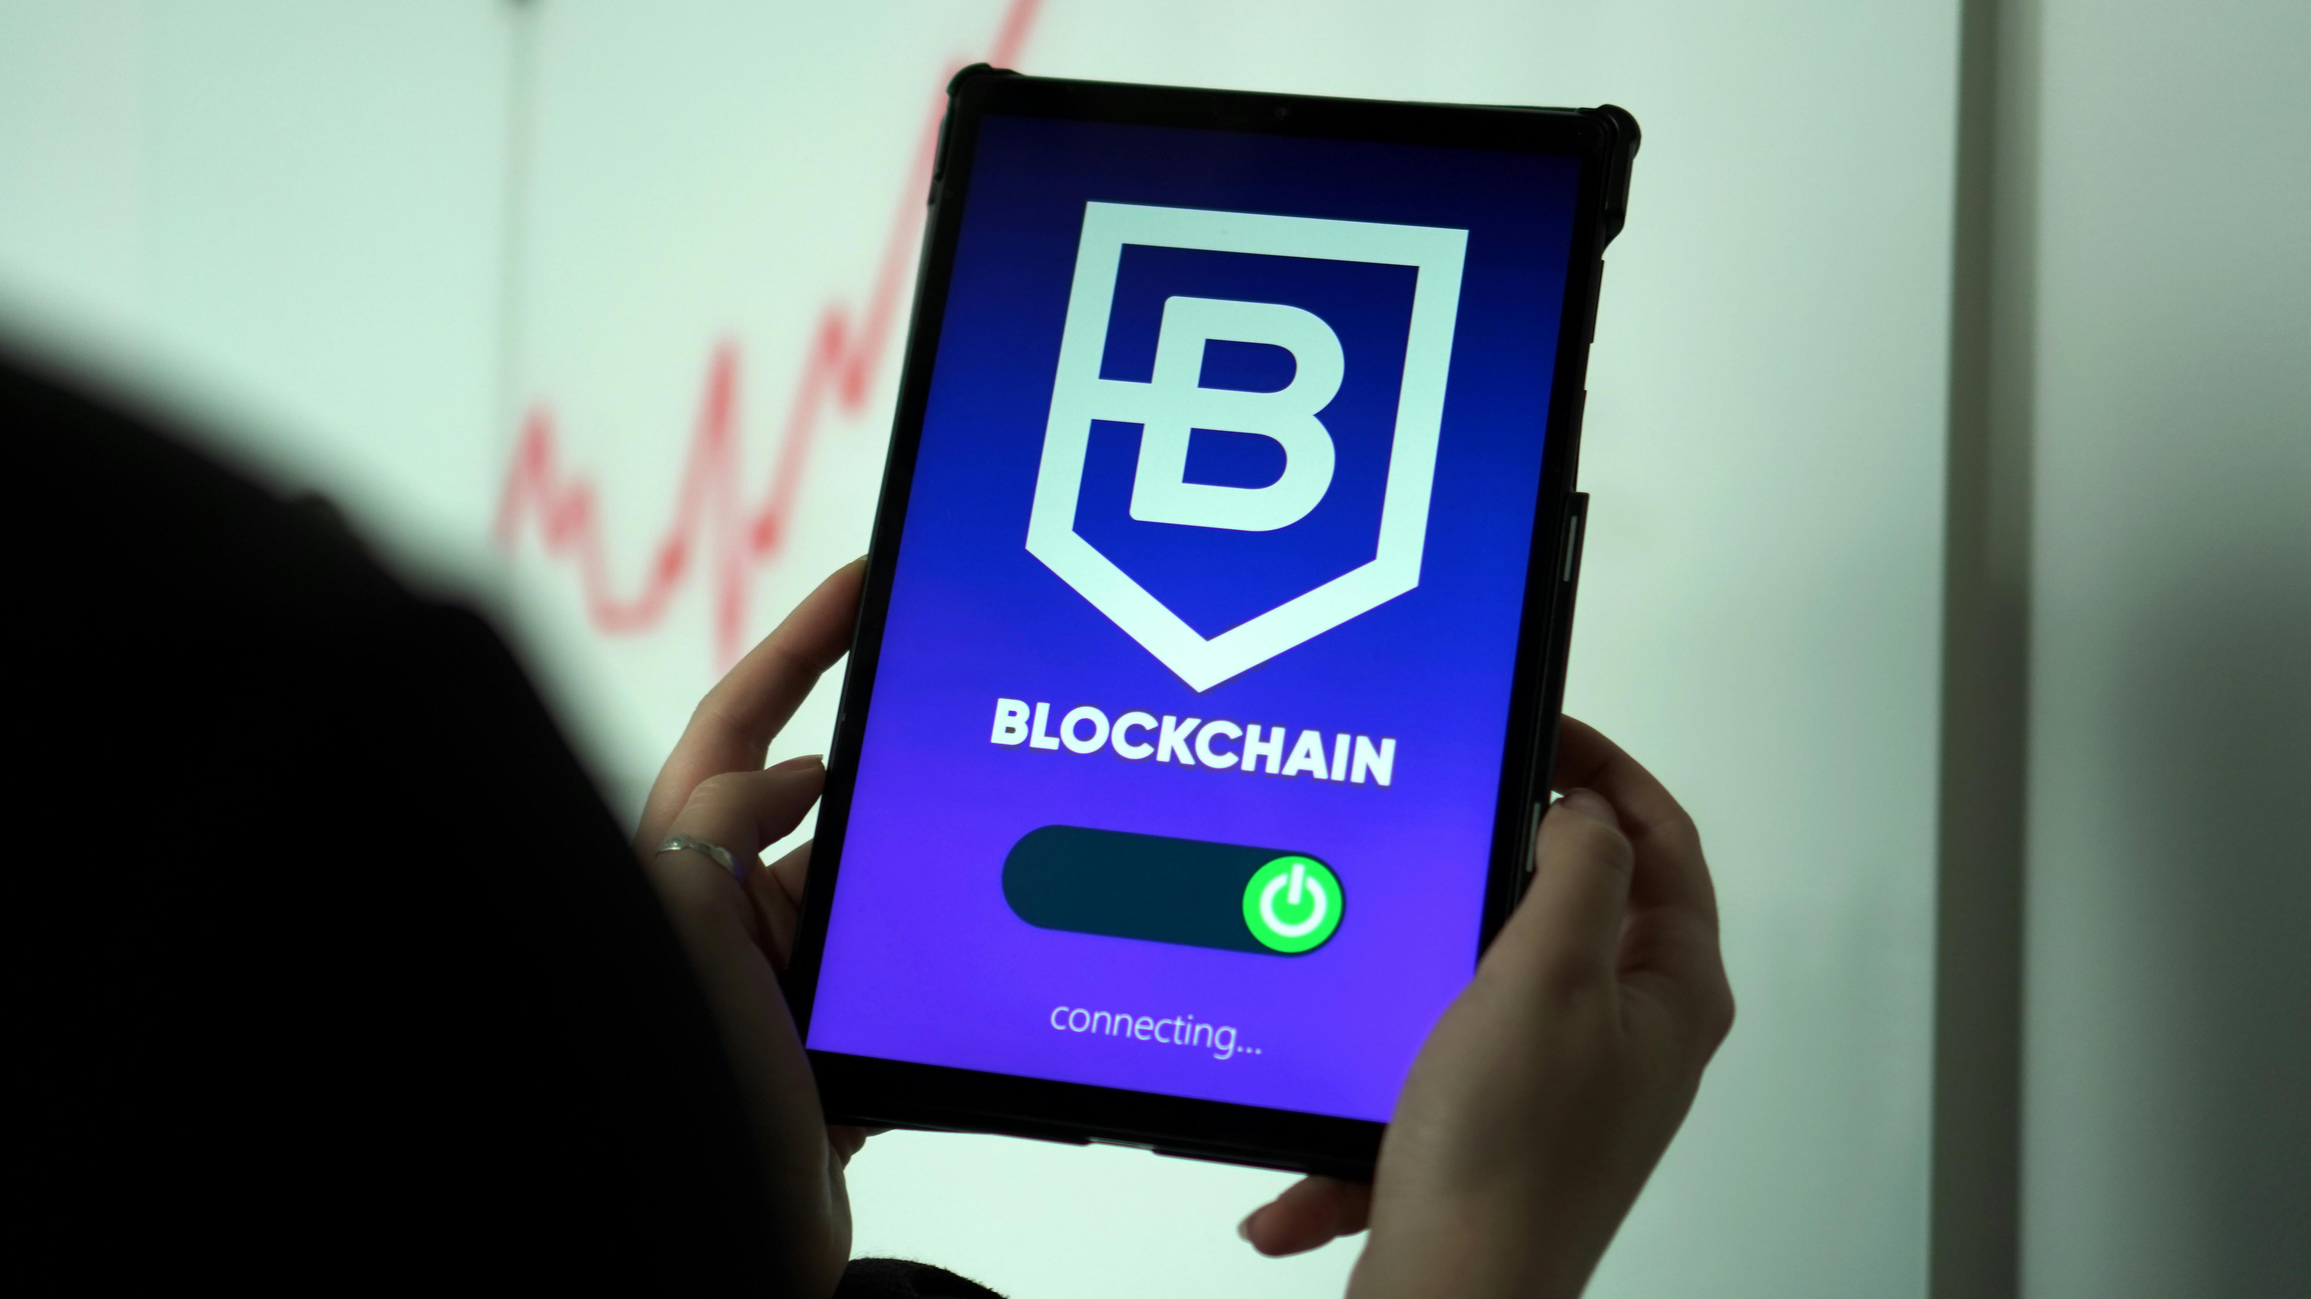
Philippines Market
📈 Trending: Tawi-Tawi Signs Digital Transformation Pact, DICT Recognizes VG Al-Syed Sali
This trending article from politiko.com.ph reports on Tawi-Tawi signing a digital transformation pact and the DICT recognizing VG Al-Syed Sali. With 2 social shares, it highlights regional digital initiatives.
Source: politiko.com.ph

Slide 20
Top Competitor News
2025-12-11 to 2025-12-18

Slide 21

Globe Telecom
Globe Boosts Southern Philippines Connectivity with Mindanao Submarine Cable
Globe Telecom is set to deploy a new 48-core, 175-kilometer submarine cable system in Mindanao by early 2026, connecting Zamboanga to Isabela City in Basilan, with an extension to Sulu. This major infrastructure project aims to enhance network resilience, expand capacity, and support broadband and mobile services in underserved southern Philippine communities, aligning with the National Broadband Plan.
Source: Globe Telecom (search for article)

Slide 22

Globe Telecom
Globe Partners with FPIP to Deliver High-Speed Fiber to Industrial Park
Globe Telecom has partnered with First Philippine Industrial Park (FPIP) to provide enterprise-grade fiber internet to over 150 locators and 80,000 employees in the Batangas industrial park. This strategic agreement aims to enhance operations, collaboration, and productivity for global and local manufacturers through seamless, secure, and high-speed digital tools.
Source: BusinessWorld Online

Slide 23
Globe Telecom
Globe Enhances Digital Security with OTP-Free Verification and Open APIs
Globe Telecom is strengthening its digital ecosystem security by advancing network-level open APIs for real-time verification and fraud detection, aiming to build trust in the digital economy. Concurrently, Globe and GCash have completed the first phase of testing Silent Network Authentication (SNA), an OTP-free verification technology designed to make digital transactions more secure and seamless.
Source: Inquirer Business

Slide 24

Converge ICT
Converge ICT Accelerates B2B Transformation with New Data Centers & Leadership
Converge ICT is aggressively transforming into a full-fledged technology and business solutions provider, marked by the relocation of its Global Business Group headquarters to Bonifacio Global City and the appointment of world-class executives. This strategic pivot is complemented by the construction of two new state-of-the-art data centers in Metro Manila and Pampanga, with a combined capacity of 1,500 racks, aiming for Uptime Institute Tier III certification.
Source: Tech Patrol

Slide 25
DITO Telecommunity
DITO Partners with AdventEnergy for Reliable Cell Tower Power Supply
DITO Telecommunity has entered a strategic partnership with AdventEnergy, Aboitiz Power Corporation's retail electricity supply arm, to provide electricity to 1,642 of its cell towers. This collaboration aims to ensure a reliable power supply for DITO's expanding network infrastructure across the Philippines, strengthening its operational backbone.
Source: Developing Telecoms (search for article)

Slide 26
Significance to Our Business
Accelerated Infrastructure Race: PLDT's massive AI-ready data center investment and Globe's Mindanao submarine cable project highlight an intensified race for digital infrastructure dominance, particularly in hyperscale and regional connectivity, demanding our strategic response.
Evolving Regulatory Landscape: The 'Konektadong Pinoy Act' introduces stringent cybersecurity and audit mandates, requiring all providers to reassess operational standards and compliance, while DICT's cybercrime report indicates ongoing challenges and opportunities in digital security.
AI as a Core Growth Driver: PLDT's emphasis on AI's economic contribution (8-12% GDP by 2030) underscores the imperative to integrate AI capabilities into our services and infrastructure, leveraging 5G and edge computing for national digital transformation.
Enhanced Digital Trust & Security: Globe's initiatives in OTP-free Silent Network Authentication and open APIs for fraud detection set new benchmarks for secure and seamless digital transactions, pressuring us to innovate our own security protocols and user experience.
Intensified Enterprise & Regional Competition: Converge's aggressive B2B transformation with new data centers and leadership, alongside Globe's focus on industrial parks and underserved regions, signals heightened competition in both enterprise solutions and expanding market reach.

Slide 27
End of Report

